Slide 1
CodeQuest
The new Learning app

Slide 2
Introduction
In modern days, technology is evolving very fast, even faster than our brains can comprehend or more importantly keep up. With this evolution comes he increased demand for jobs within this domain.
Also in modern society, what used to take people months to comprehend is now taking children and babies days to understand. Of course, we are talking about electronic devices like smart phones, computers, and TVs. “What are the implications?” is an important question and topic regarding this phenomenon in health and morals. However, it is not asked enough concerning their future careers or even thought process in this domain. How they are being introduced to technology will influence how they perceive it in the long run.
This workforce did not start development in university. It started when the highschoolers started considering the major because of the opportunities. This is our target audience.
There is an app called “Duo Lingo”. It is specialized in teaching languages to users. From this, I got the idea for “CodeQuest”. Its purpose is to slowly introduce the user to a certain language and when they pass a certain test, they go on to the other. This way, potential computer scientists would be setting on the correct path to have a strong base in coding, while being motivated to unlock new heights and skills.

Slide 3
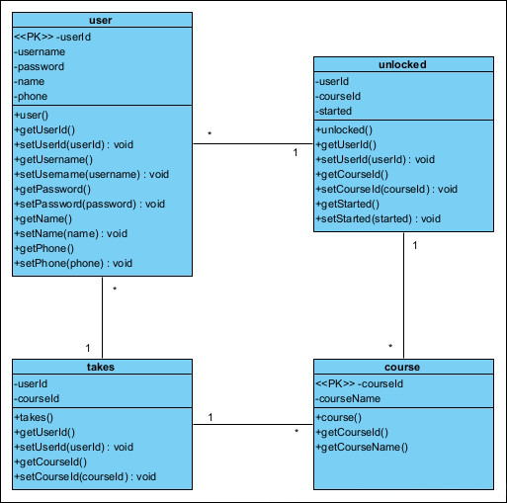
Class Diagram
We will have 2 main classes: user and course. These will contain all information regarding registered users and available courses.
To relate them and facilitate the connection with the frontend application, we will use two tables: takes and unlocked.
Takes will show what courses a user started and is taking.
Unlocked will show what courses a user can start.
These will only show superficial information regarding identification.

Slide 4
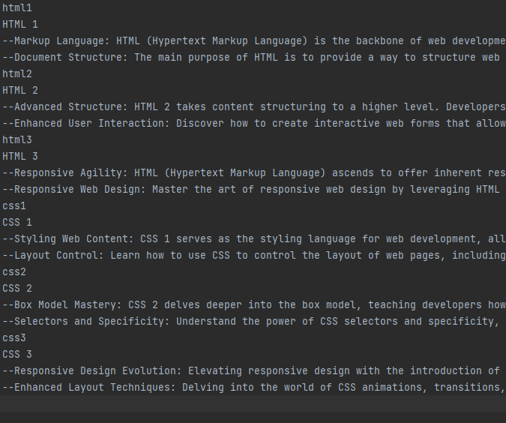
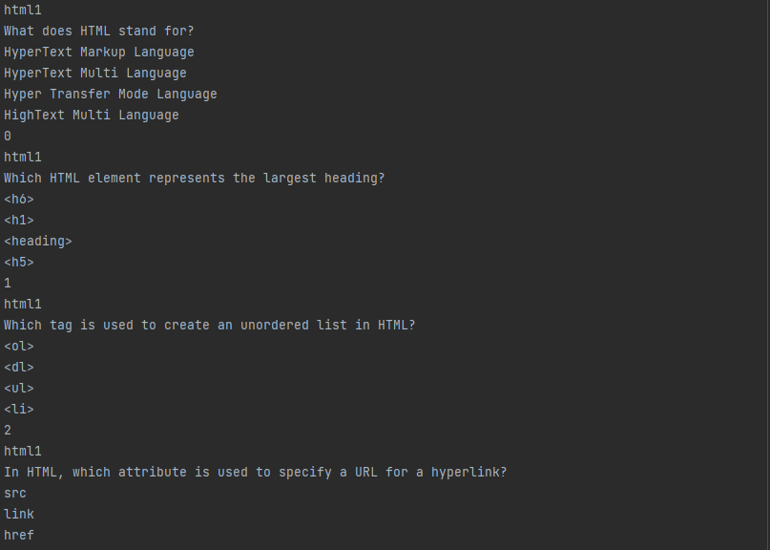
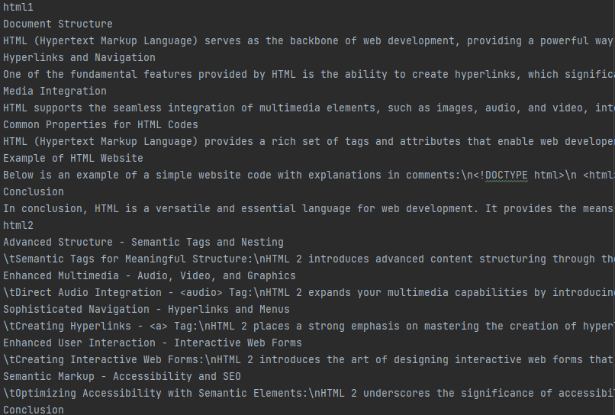
Class Diagram
The information will be stored in text files (.txt)
They will be accessed from the application through a for loop associating the requested ids to the ones found.

Slide 5
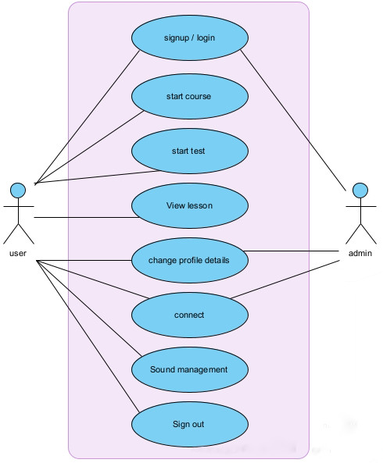
Use Case
The user can use all functions in the application. The reason being all editing and data access privileges are left to the admin in the actual code.

Slide 6
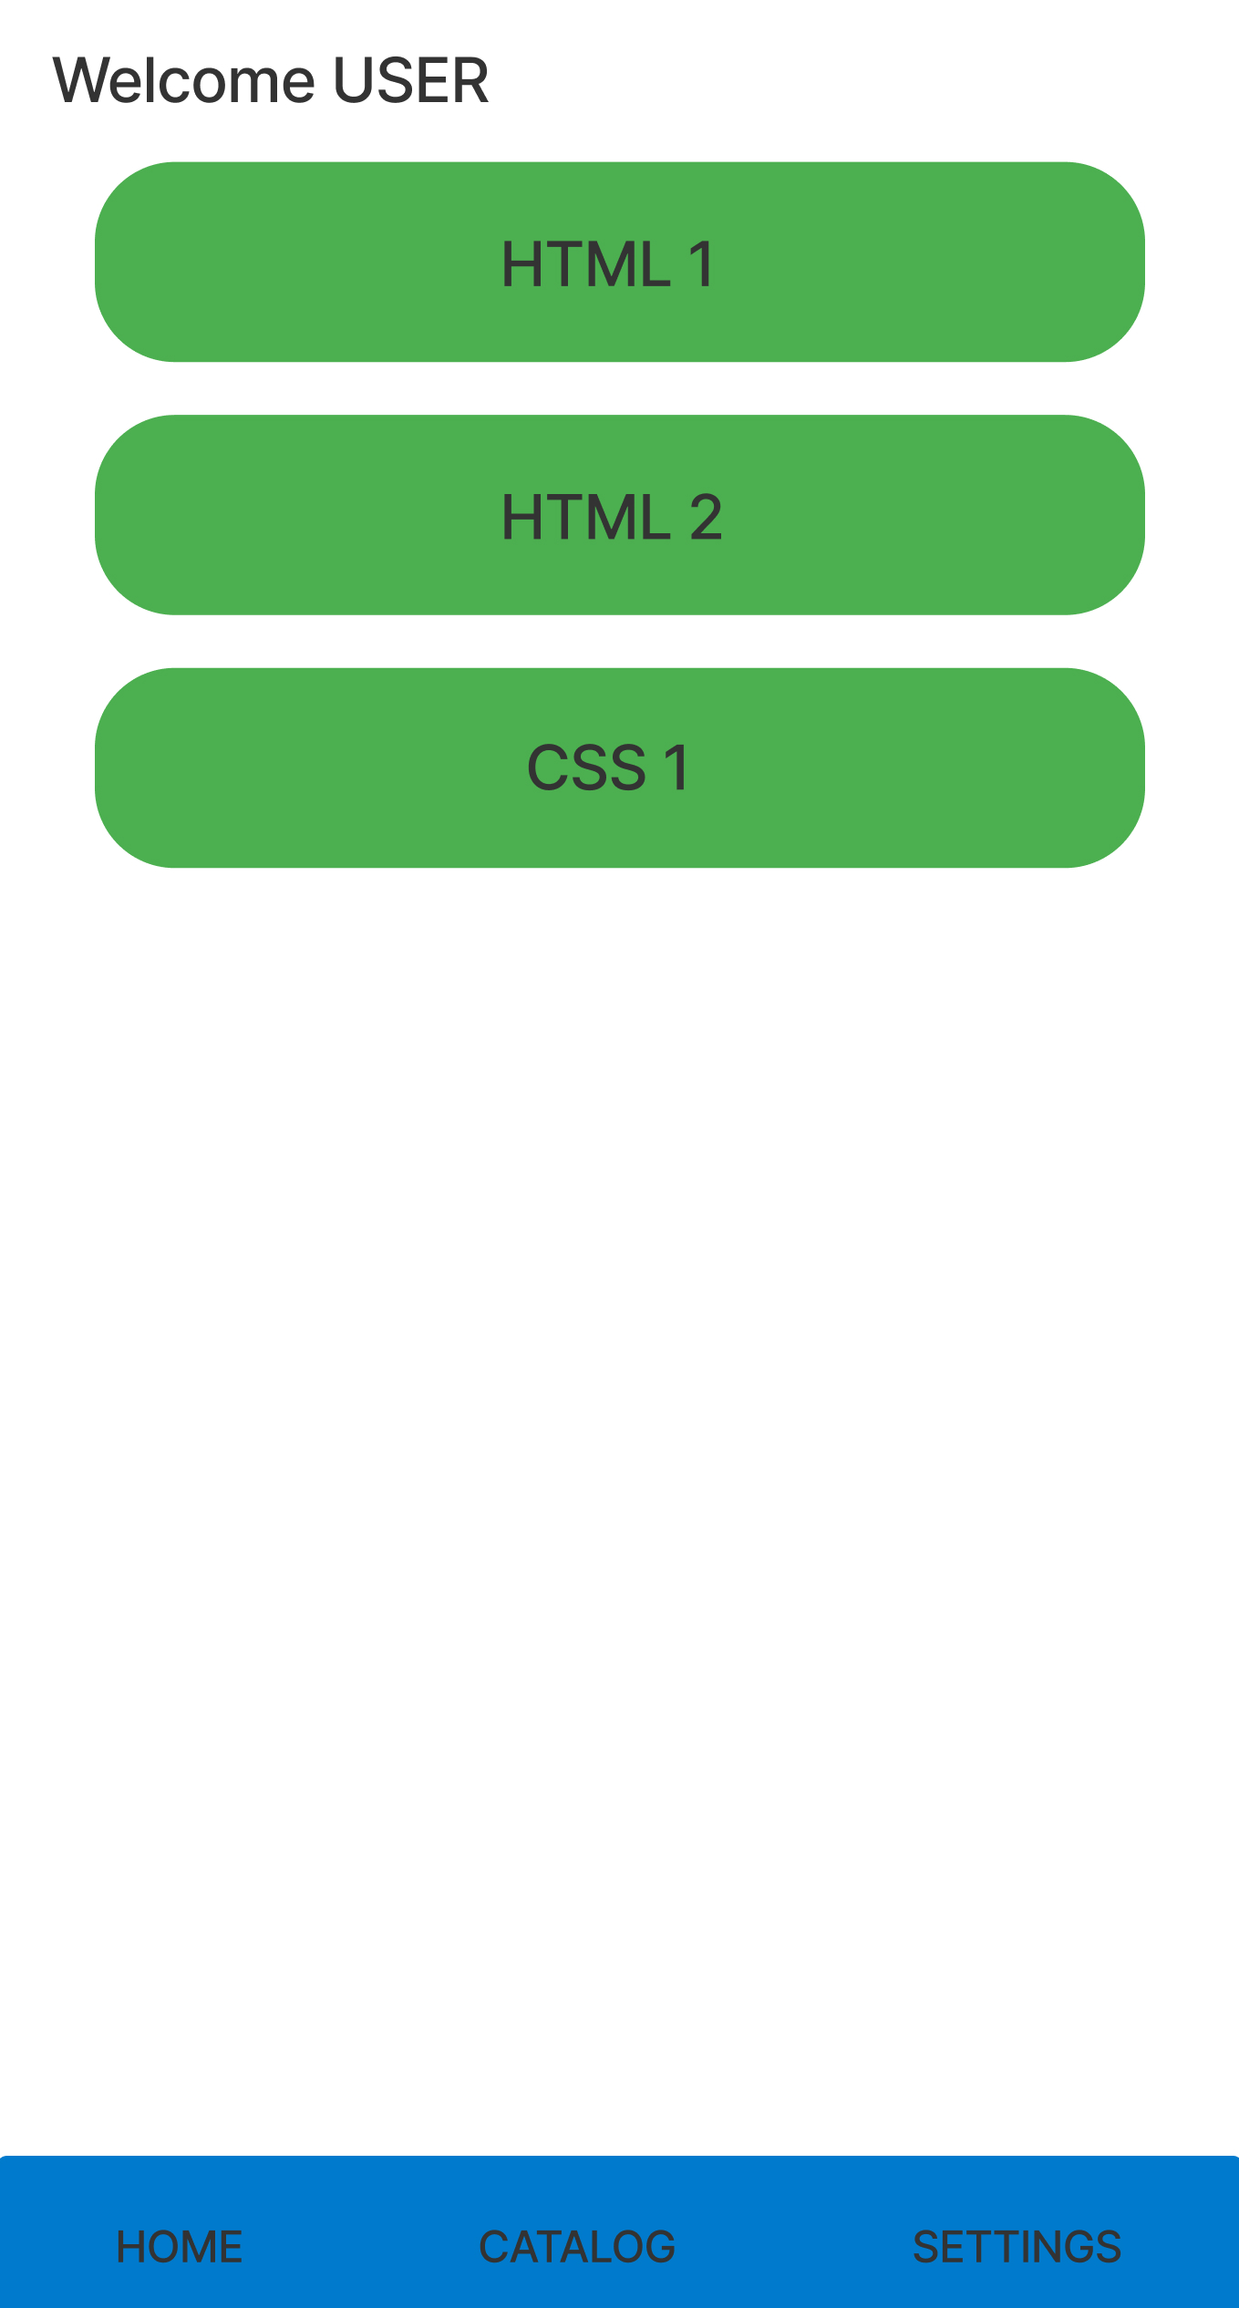

Slide 7
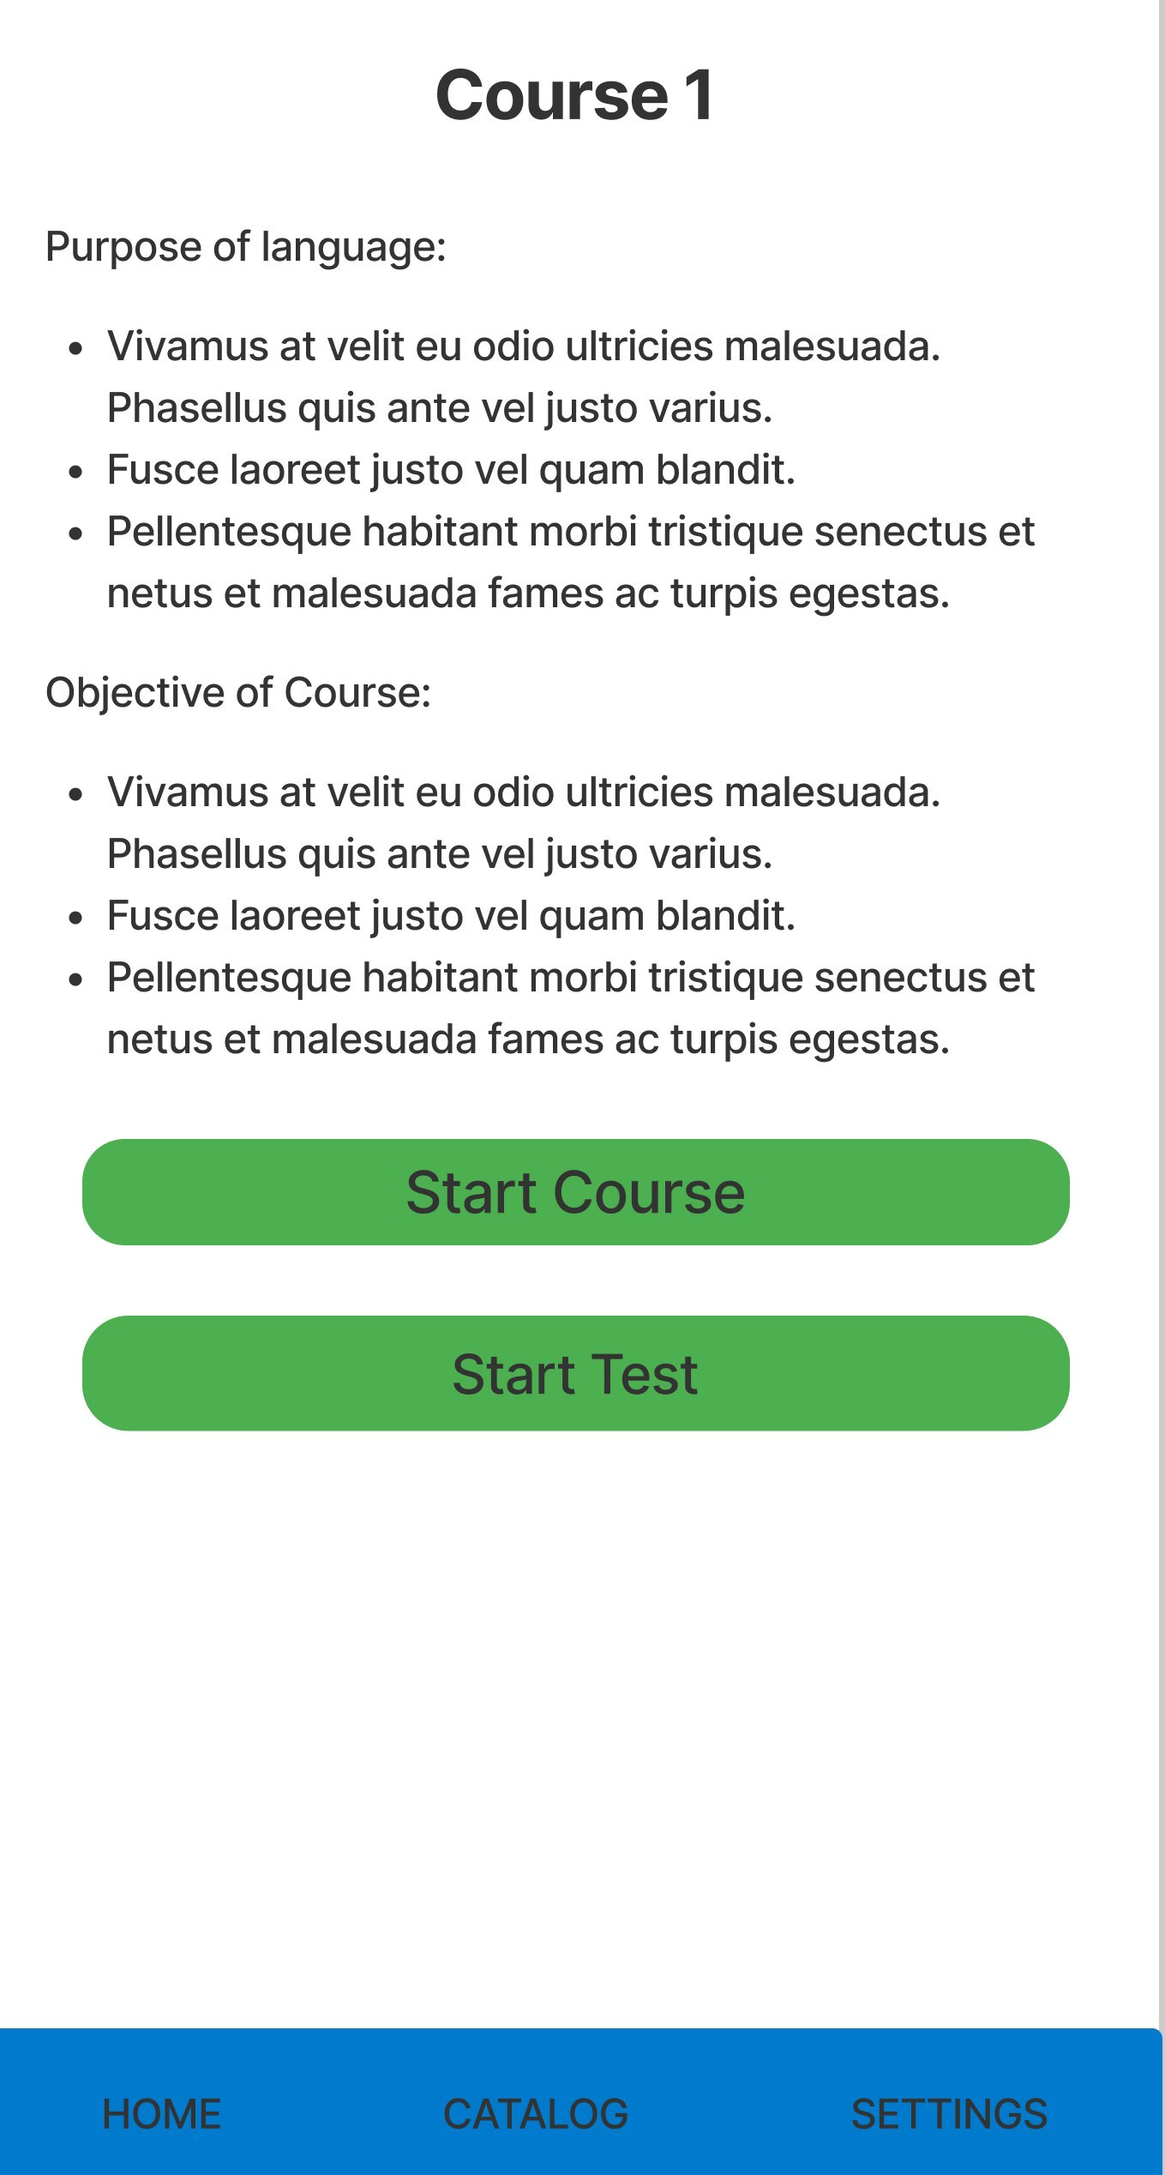

Slide 8
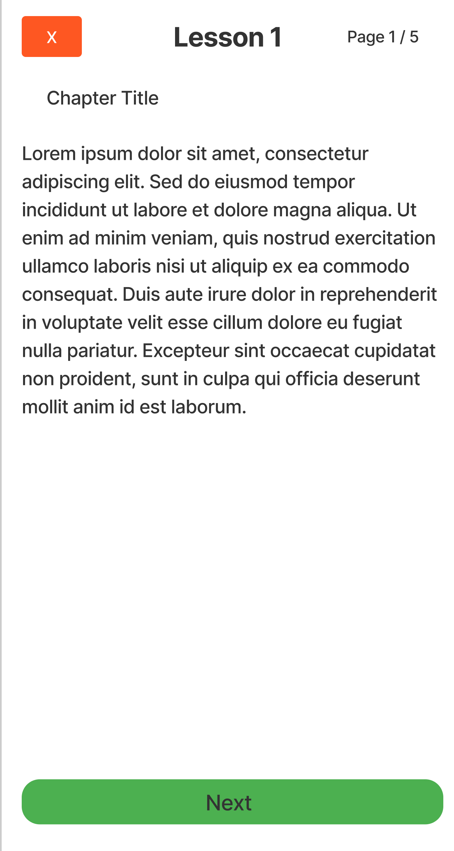
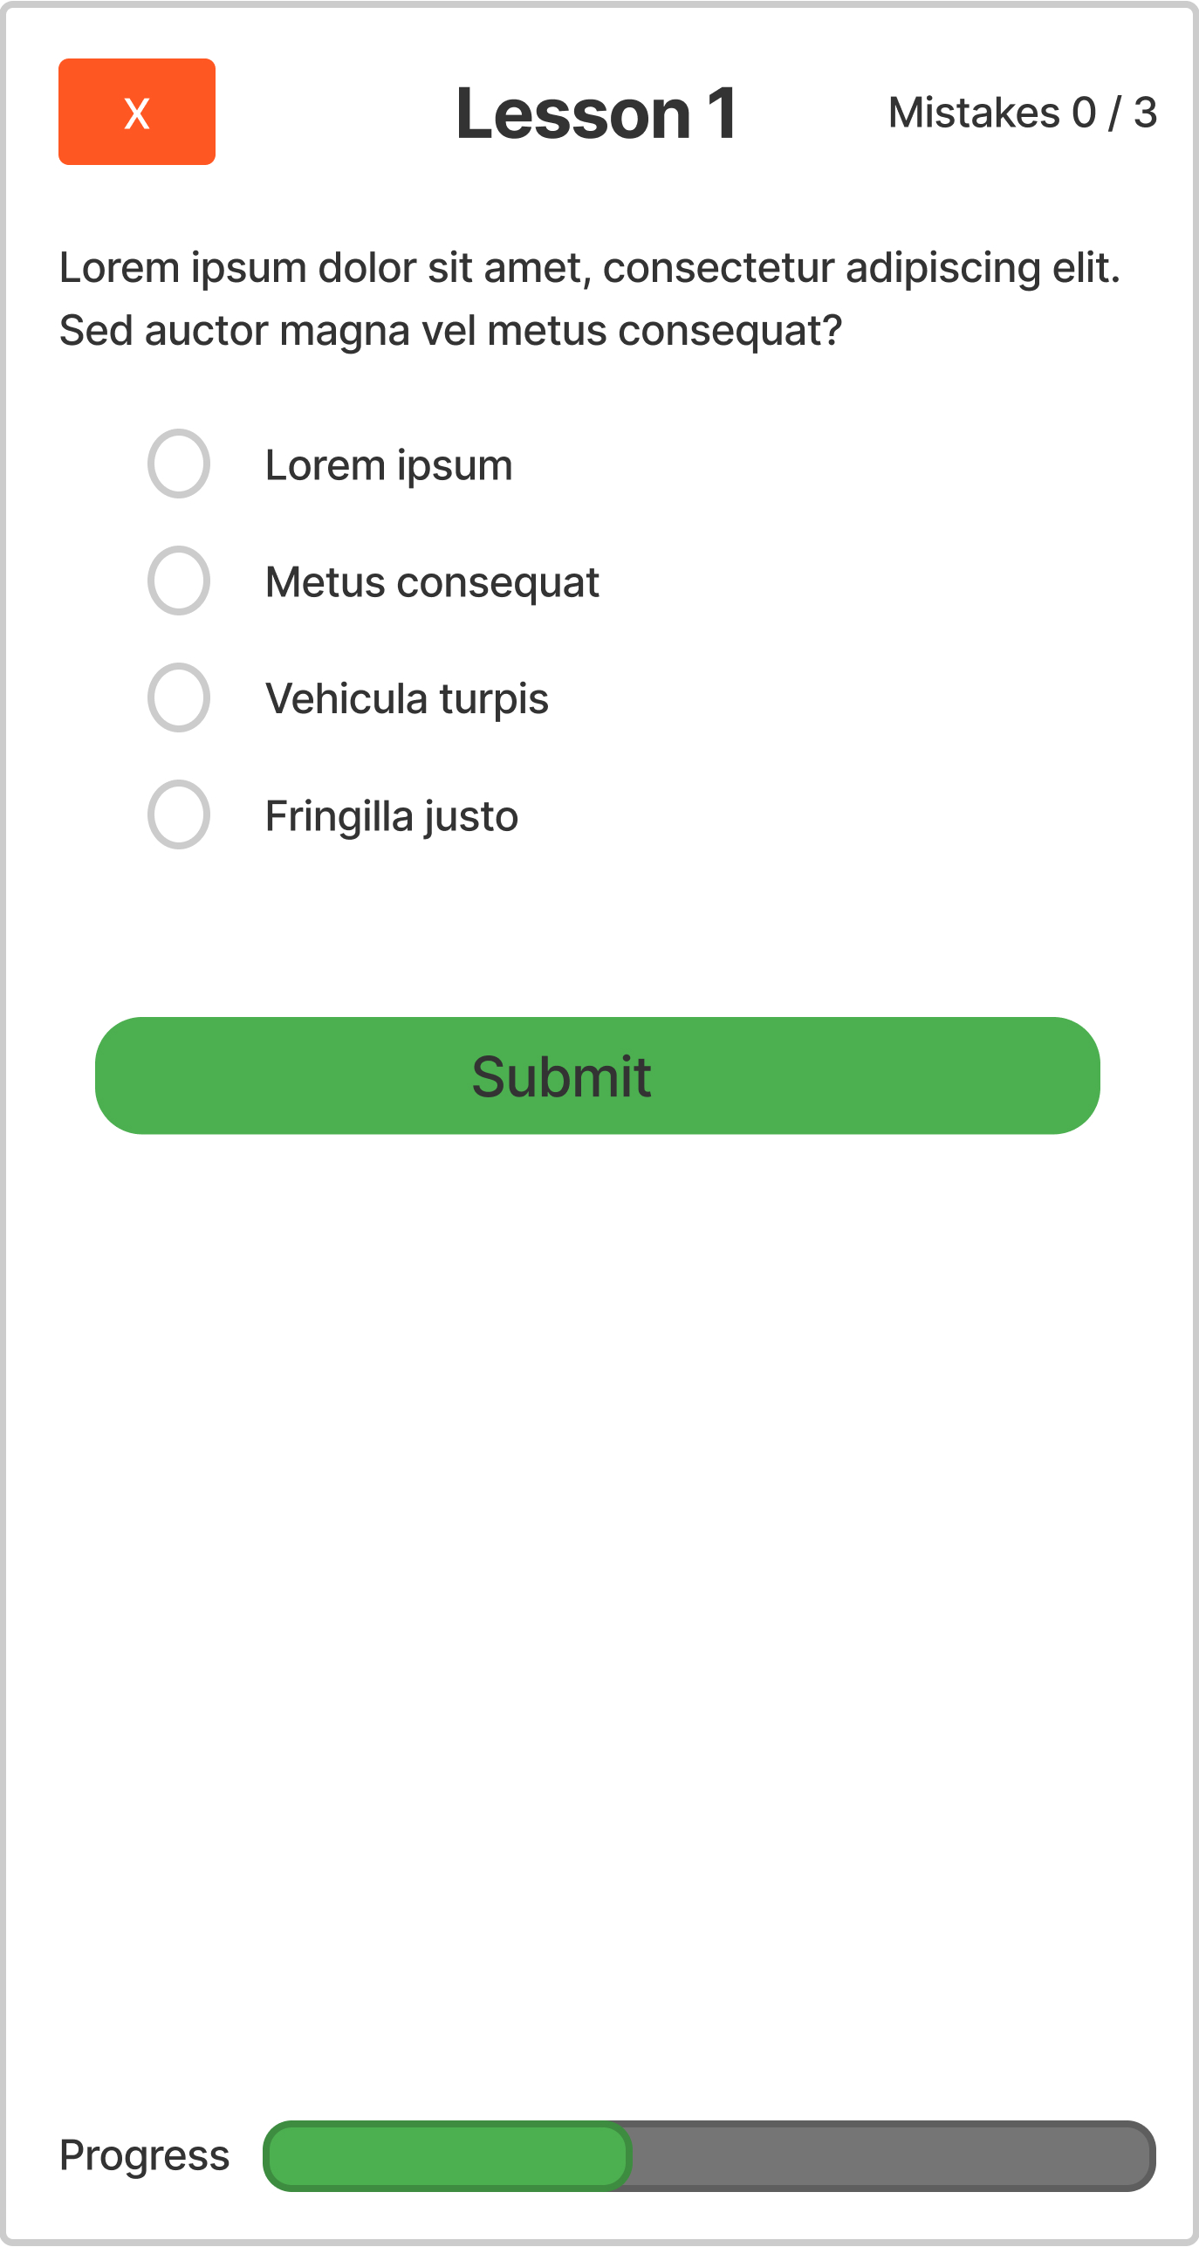

Slide 9
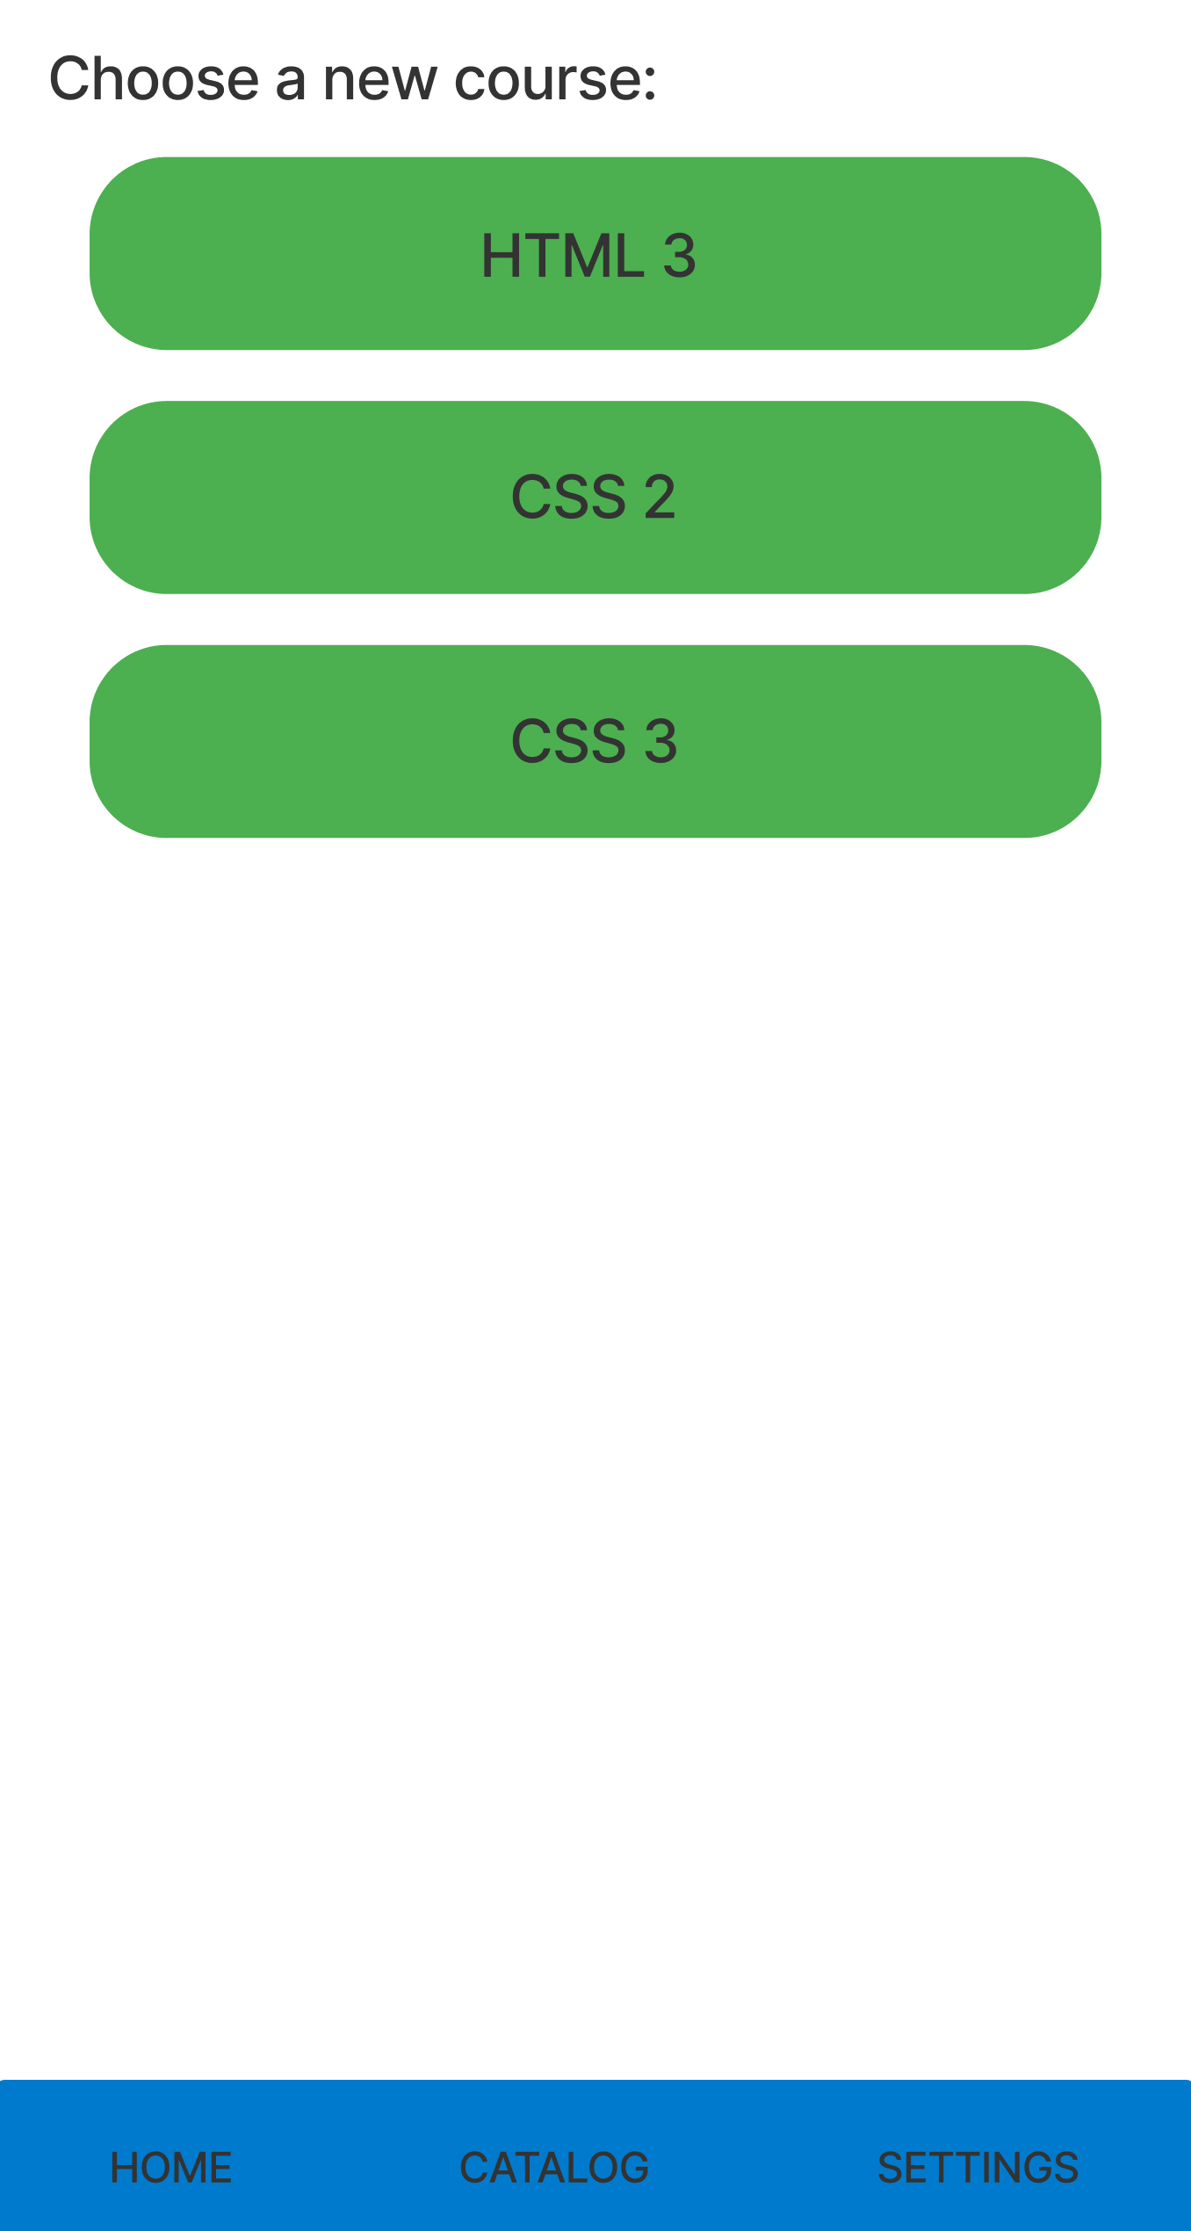

Slide 10
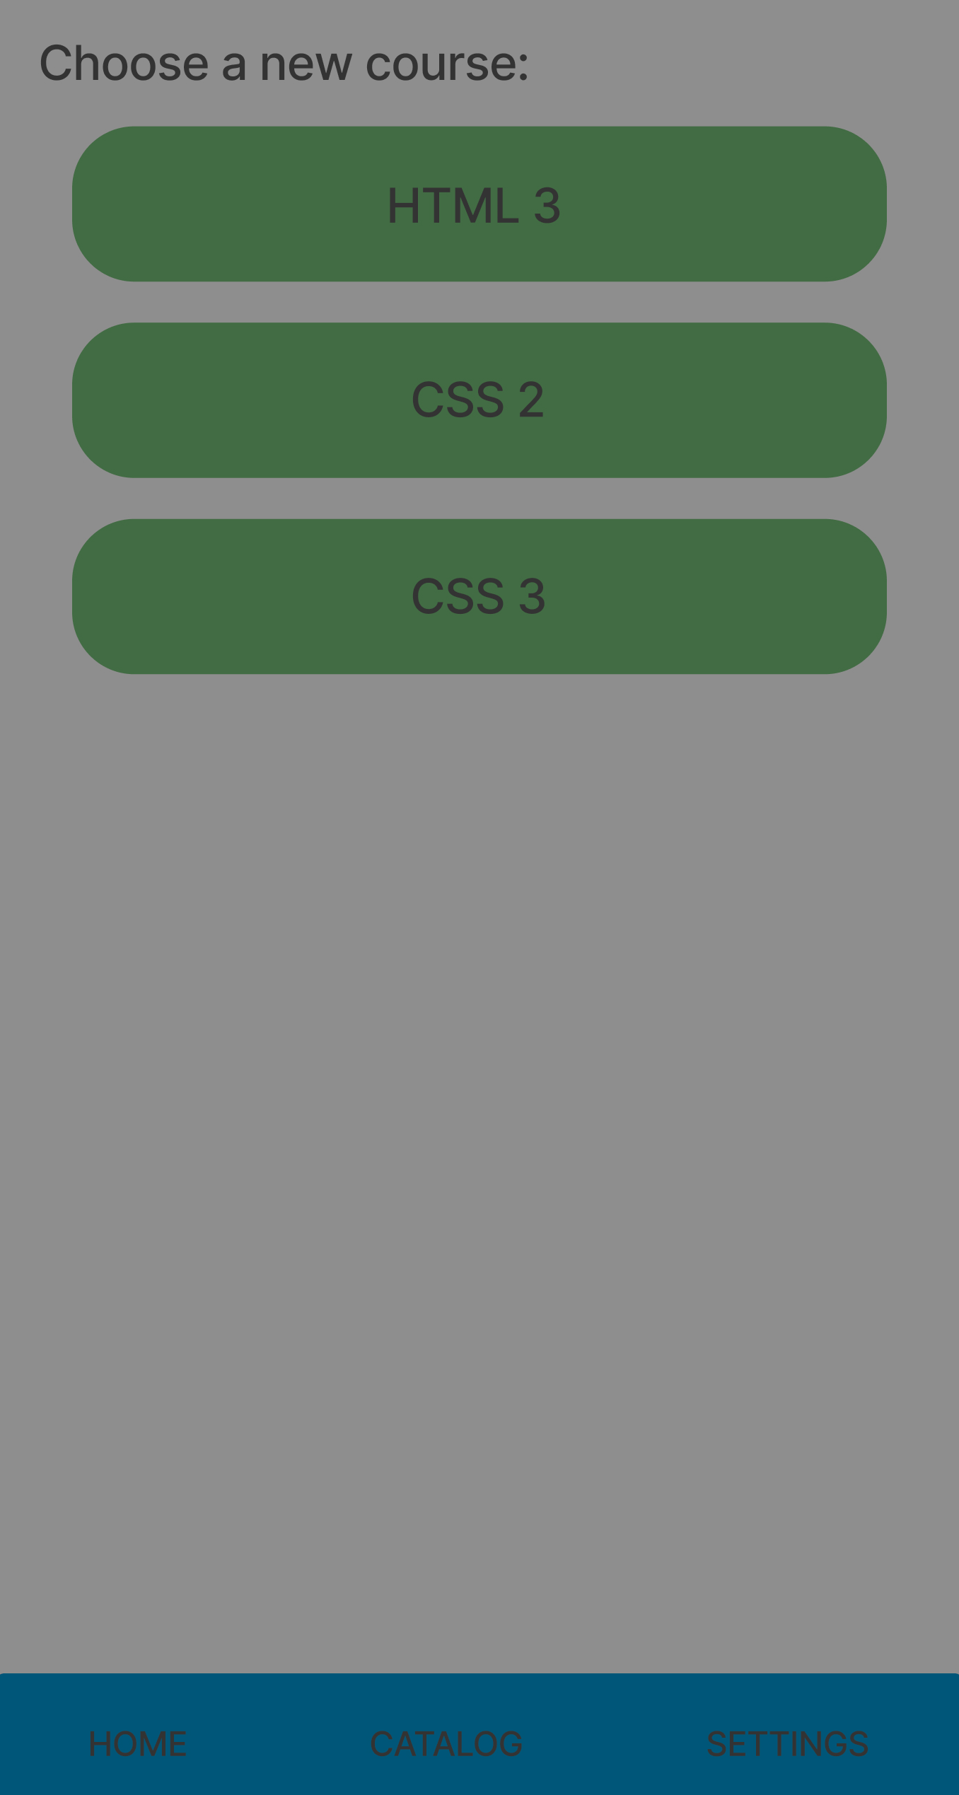
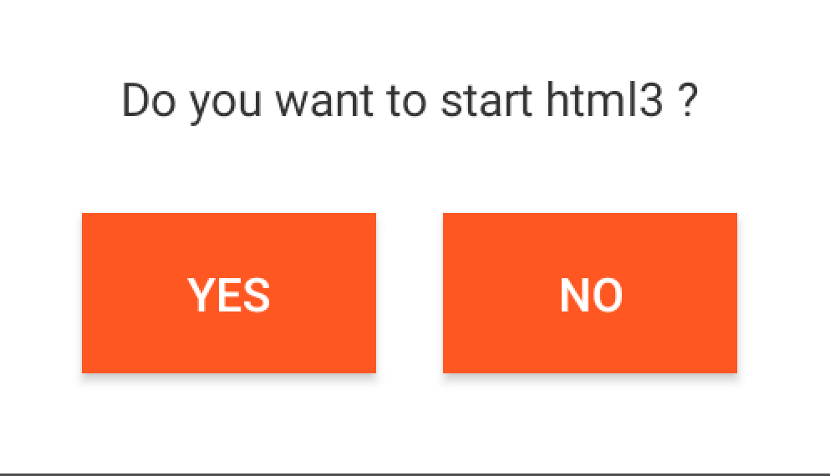

Slide 11
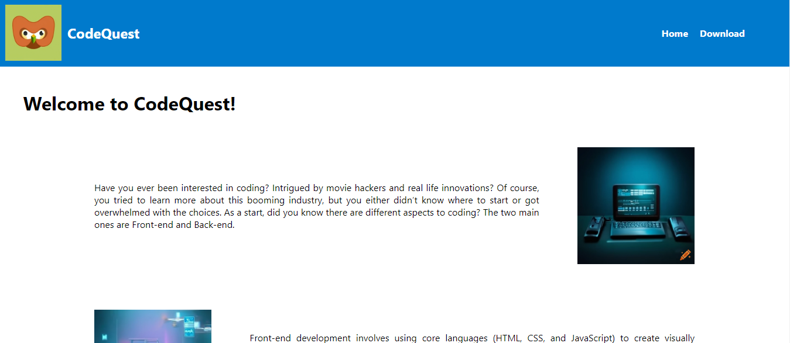


Slide 12
